Slide 1
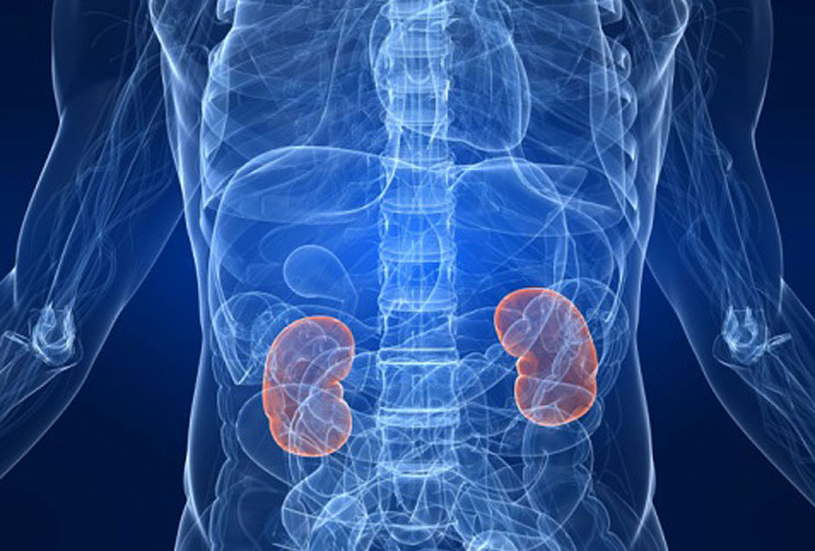
Chronic Kidney disease (CKD）
Fadilla Zennifa
Holmusk Hiring process

Slide 2
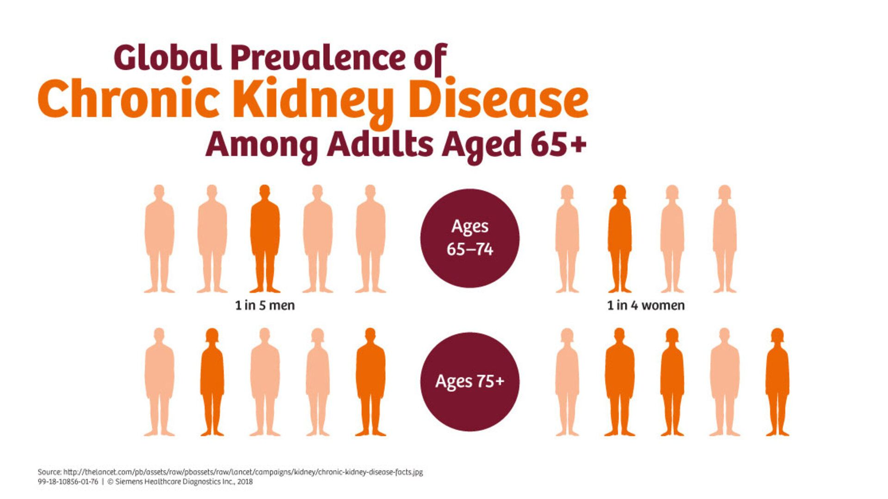
Background

Slide 3


Methodology (Tools)
Data Mining
statistic

Slide 4
Methodology(Features)
valuecreatine
valueDBP
valueglucose
valueHGB
valueLDL
valueSBP
Age
Those selected features inspired by reference [1]

Slide 5
Methodology (Process)
Pre-Processing
Feature selection
averaging value
Normalization
Learning
Supervised Machine Learning
Error Analysis
Precision
MCC
ROC
Model
Data
Input
Processing
Model

Slide 6
Methodology (ouput)
Progress
Class
No Progress

Slide 7
Results (Demographics)

Slide 8
Training
(60%)
Testing
(40%)
Highest performance
81.11 %

Slide 9
Discussion
=== Detailed Accuracy of Training kNN (k=3) By Class ===
TP Rate FP Rate Precision Recall F-Measure MCC ROC Area PRC Area Class
0.596 0.089 0.756 0.596 0.667 0.545 0.854 0.662 TRUE
0.911 0.404 0.830 0.911 0.868 0.545 0.854 0.900 FALSE
Weighted Avg. 0.811 0.304 0.806 0.811 0.804 0.545 0.854 0.825
=== Confusion Matrix ===
a b <-- classified as
34 23 | a = TRUE
11 112 | b = FALSE

Slide 10
References
“Chronic Kidney Disease Tests & Diagnosis.” National Institute of Diabetes and Digestive and Kidney Diseases, U.S. Department of Health and Human Services, 1 Oct. 2016, www.niddk.nih.gov/health-information/kidney-disease/chronic-kidney-disease-ckd/tests-diagnosis. (Access: February 27th, 2020)

